Slide 1
DevOps @ The Friedkin Group
Natty Gur
VP & CIO

Slide 2

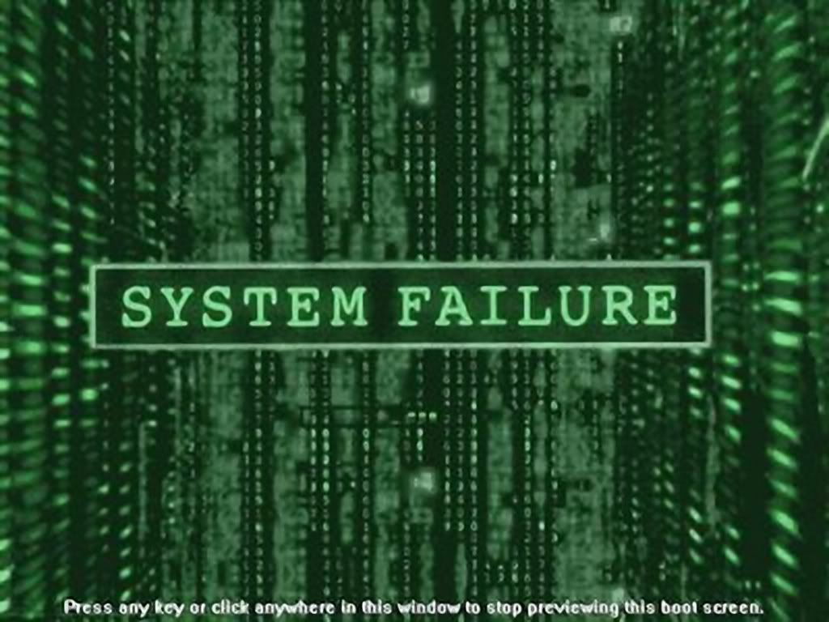
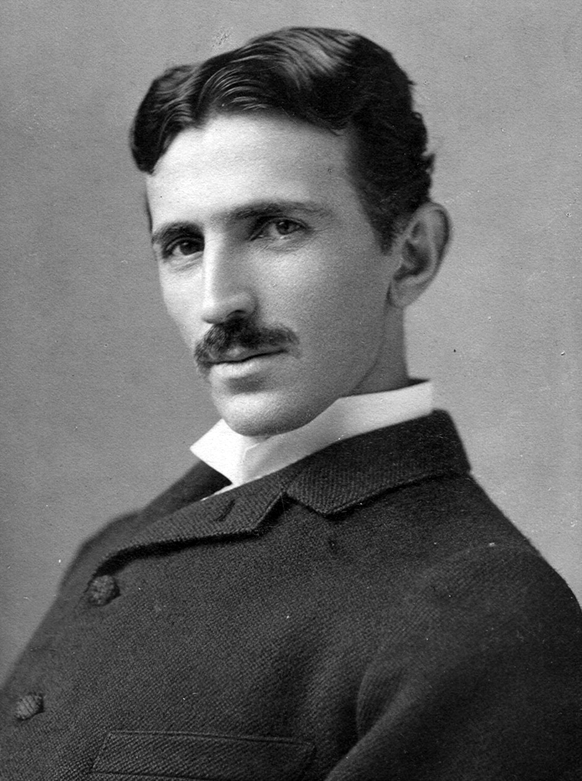
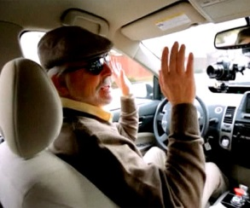


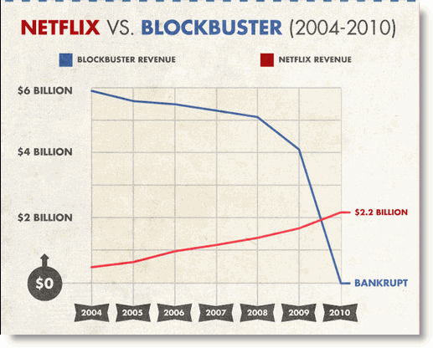



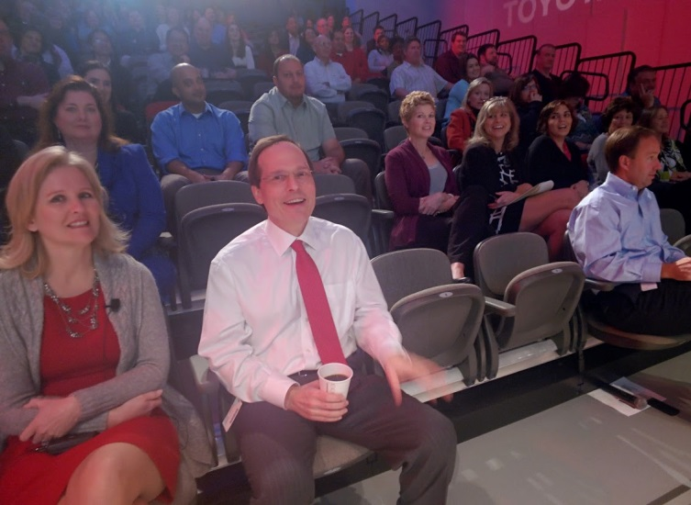
The Drive
System(atic) Failure
Group is better than individuals
Our competitive advantage is:
Our Associates

Slide 3
What is DevOps for us
Tools &
Technologies
Concept
Culture

Slide 4
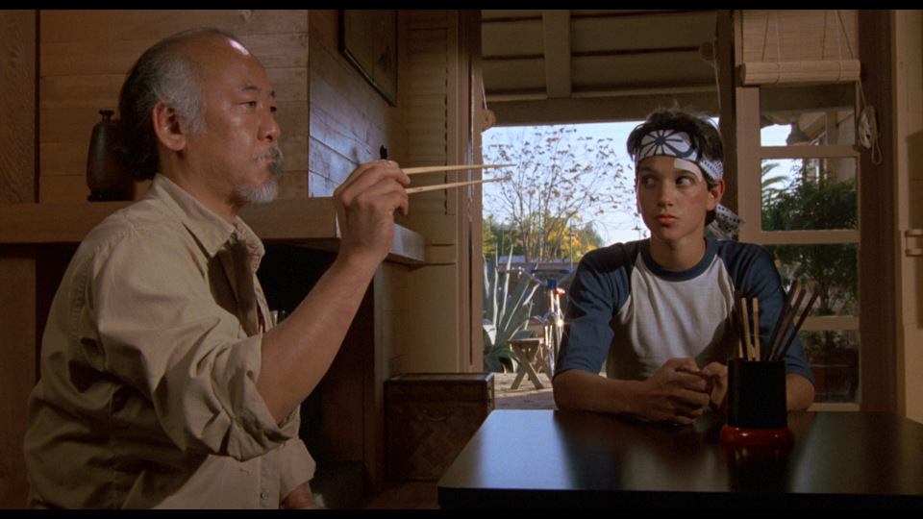
AAA Culture
Adults: we trust you as an adult to choose the right tools and methodologies to do your work. You can select your career path (technical or managerial), you can select your project methodology, and you can select the technology. You have the freedom to do your work the way you choose, if you act as an adult and you understand and communicate the implications and applications of what you are doing on the company’s success and on other associates who have dependencies on your work.
Adaptive: The world and the business environment always keep on changing. Actually the pace of those changes just keeps on growing. Businesses that want to survive in such an environment need to be adaptive and adjust to the new business climate. If we’ve done a good job as an IT group, business changes need to produce IT changes as well. Those changes can be of any shape or form (cultural, procedural, technical, etc.), and we need to adjust to them, adopt them, and not push them back. Actually in today’s business world if your business isn’t going through any type of change within a year, that should be an alarm for you.
Awesome: We are sure that you want your working day to be awesome. You want awesome people to work with, awesome projects to work for and awesome customers (that will give you awesome feedback). Well, guess what, for all of that to happen you need to be Awesome too! You need to be awesome to your peers, customers, managers, people you manage, suppliers, etc. and the most important rule, you have to do awesome work. Pay attention to details, think as the customer, make sure your solution is reusing existing components and can be reused in the future, and create solutions aligned to IT strategy and principles. In a nut shell, think about everyone that is going to be affected from your work and what you can do so they can say that you are awesome.

Slide 5
Concept – Automation & Componentization
Fit to Purpose
Agile
Cost Effective
Retain & Develop
Automation
Just be awesome WITH:
People
Work (what you are doing)
Componentization
Kai Zen

Slide 6
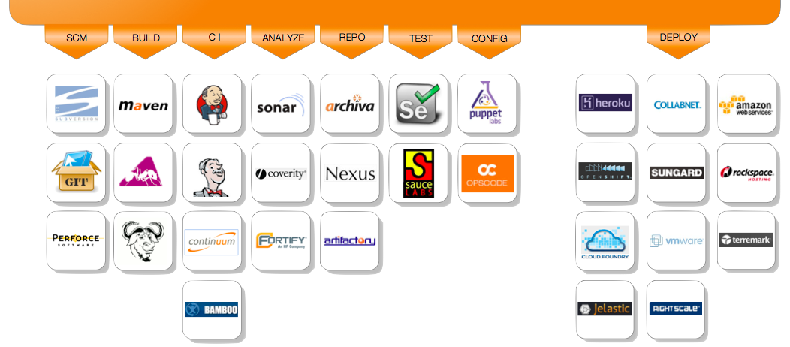
Tools & Technologies

Slide 7
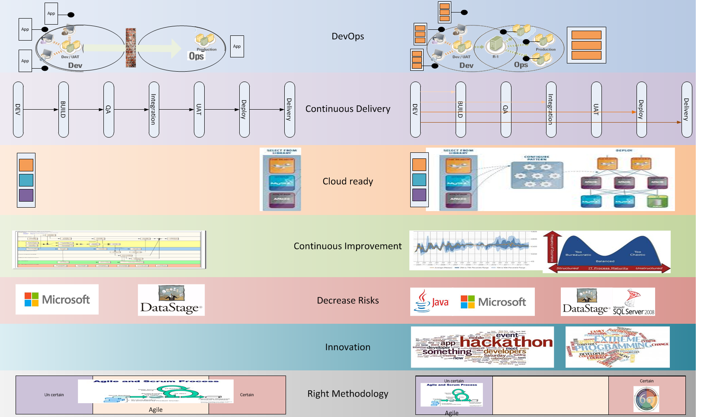
IT Direction

Slide 8
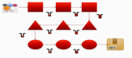

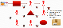
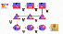
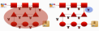
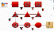
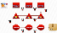
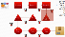
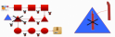
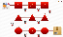
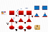
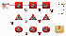
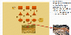
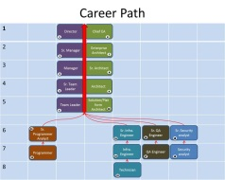
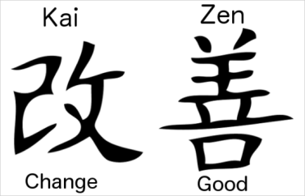
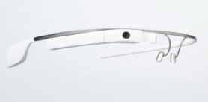
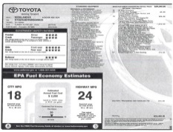
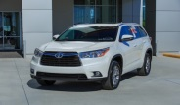

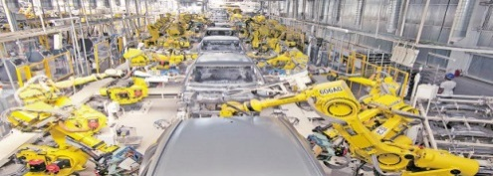
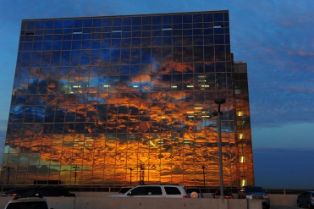






The transition
No Processes
Manual
IT Silos
Fix all
No RCA
One OEM
Fixed SLA
Single purpose
Long ROI
Duplication
Original Parts
Local Storage
IT
Developers
Operations
Mgr
Mgr
Team
Dev
Dev
Dev
Team
Dev
Dev
Dev
Team
Dev
Dev
Dev
Team
Dev
Dev
Dev
Mgr
Team
Ops
Ops
Ops
Team
Ops
Ops
Ops
Mgr
Team
Ops
Ops
Ops
Team
Ops
Ops
Ops
IT
Mgr
Mgr
Team
Ops
Dev
Dev
Team
Dev
Ops
Dev
Team
Ops
Dev
Ops
Team
Dev
Ops
Ops
Mgr
Team
Dev
Ops
Dev
Team
Ops
Dev
Ops
Mgr
Team
Dev
Dev
Dev
Team
Ops
Ops
Dev
No way!
Yes we can!
IT as a Service
Cloud Computing
Security
Provisioning / monitoring / reporting
Security
Architecture
Platform management
SaaS
(Software As A Service)
Procurement
Exchange 2013
AX
Share Point
Budget Management
PaaS
(Platform As A Service)
SSO
Single Sign On
.Net Farm
Development
SOA
Continuous Delivery
SQL
Farm
IaaS
(Infra. As A Service)
Compute
Network
Storage

Slide 9
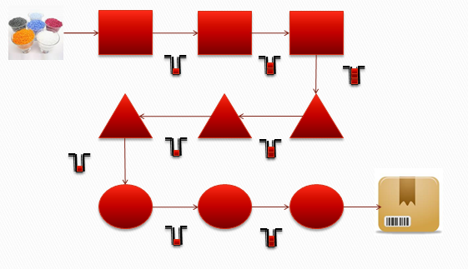
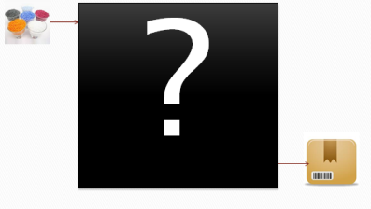
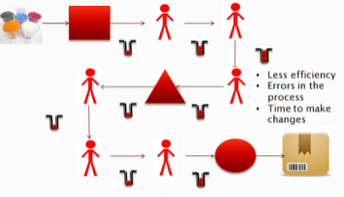
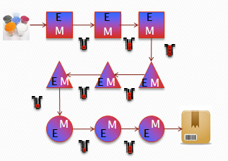

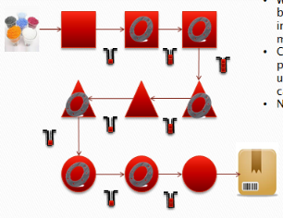
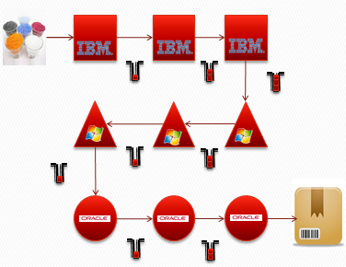
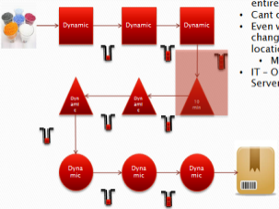

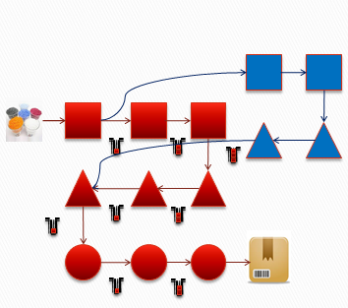
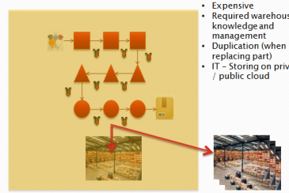
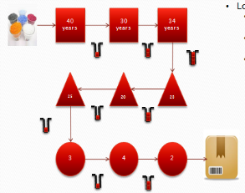
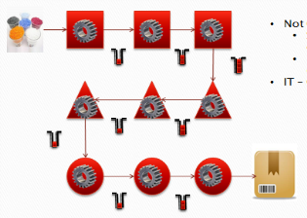
IT as a production floor (focus on tactic)
No Processes
Manual
IT Silos
Fix all
No RCA
One OEM
Fixed SLA
Single purpose
Long ROI
Duplication
Original Parts
Local Storage

Slide 10

Blur IT roles boundaries

Slide 11
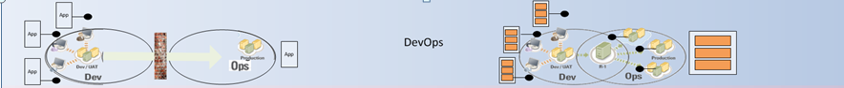
Change the Organization Chart
IT
Developers
Operations
Mgr
Mgr
Team
Dev
Dev
Dev
Team
Dev
Dev
Dev
Team
Dev
Dev
Dev
Team
Dev
Dev
Dev
Mgr
Team
Ops
Ops
Ops
Team
Ops
Ops
Ops
Mgr
Team
Ops
Ops
Ops
Team
Ops
Ops
Ops
IT
Mgr
Mgr
Mgr
Mgr
Team
Team
Team
Team
Team
Team
Team
Team
Ops
Dev
Dev
Ops
Dev
Ops
Dev
Ops
Dev
Ops
Ops
Dev
Ops
Dev
Dev
Ops
Dev
Ops
Dev
Ops
Dev
Ops
Dev
Dev
“One Goal - One Team”

Slide 12
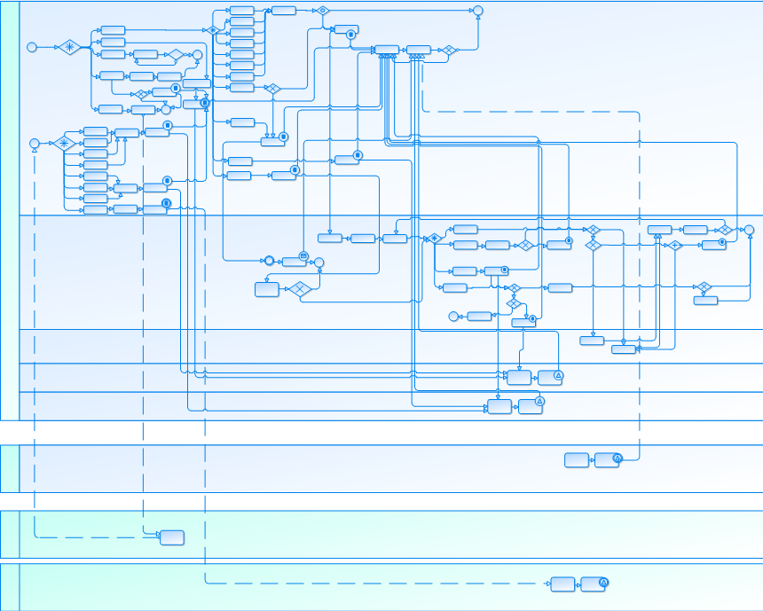

Continuous improvement

Slide 13
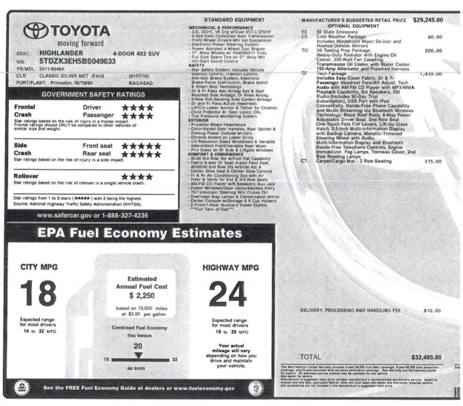

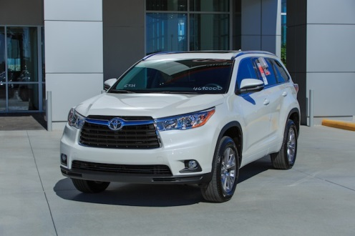
Innovation
FEDX
Hackathon

Slide 14
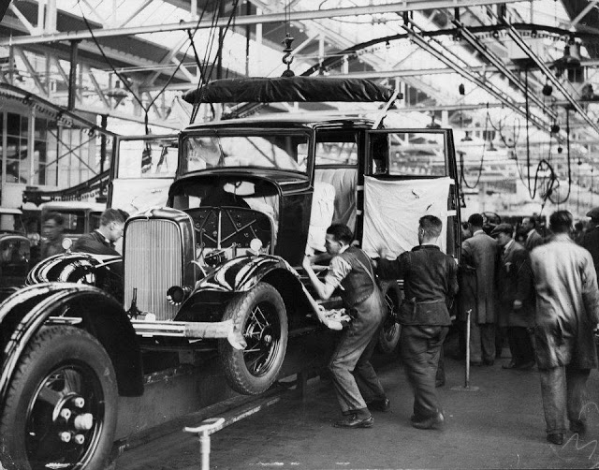

IT Automation
“I need this new feature by next Friday”
No way!
Yes we can!

Slide 15
Build cloud ready solutions and platform to host them
IT as a Service
Cloud Computing
Security
Provisioning / monitoring / reporting
Security
Architecture
Platform management
SaaS
(Software As A Service)
Procurement
Exchange 2013
FI
Share Point
Budget Management
PaaS
(Platform As A Service)
SSO
Single Sign On
.Net Farm
Development
SOA
Continuous Delivery
SQL
Farm
IaaS
(Infra. As A Service)
Compute
Network
Storage

Slide 16

InSoursing

Slide 17

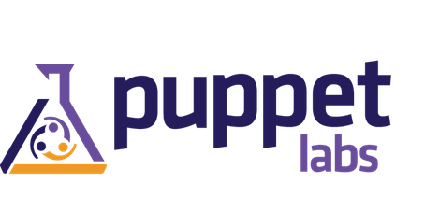
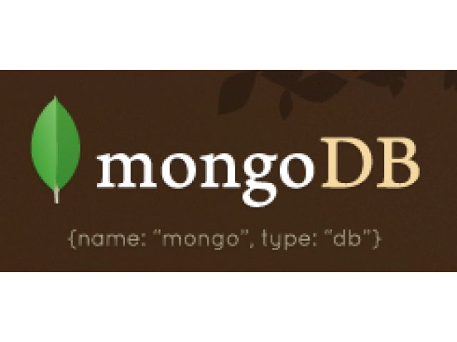

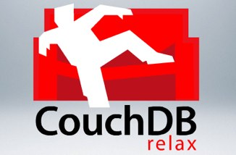
Tools Implementation

Slide 18
What we achieved so far
Better IT
No pointing figures
Reduce time to turn an idea into solution in production
From 60% to 99.9% of successful on boarding
Reduce IT costs
Better working environment

Slide 19
What we can do different
Reduce time from organization change to actual DevOps working
Prepare better managers to work in new environment
Be aware of people resistance to unstructure working environment

Slide 20
Thank you
Questions/ comments
ngur@friedkin.com
FC_CIO
FriedkinGroupCio.com

Slide 21
Structure Vs. Unstructured
Defined roles and responsibilities
Creativity
Well defined tasks
Defined project
Agility
Consistent feedback
Following Procedures
Documentation
Chaos
Unstructured
Structured

